Slide 1
ACT NOW – Meningitis B vaccination programme
Full-time undergraduate students living in halls of residence:
Ensure you get your second vaccination
The first vaccination will not protect you from meningitis B – you need to have the second to ensure protection from the disease. Read your emails and come to your allotted time slot:
Tuesday 6 June – 9.30am to 7pm
Wednesday 7 June – 9.30am to 7pm
Thursday 8 June – 9.30am to 7pm
Friday 9 June – 12pm to 7pm
Report to the marquee on PATS field for your second vaccination.
For information on why you need the vaccine visit surrey.ac.uk/meningitis.
Missed the first vaccine? There is still time. Read your emails or visit surrey.ac.uk/meningitis.

Slide 2
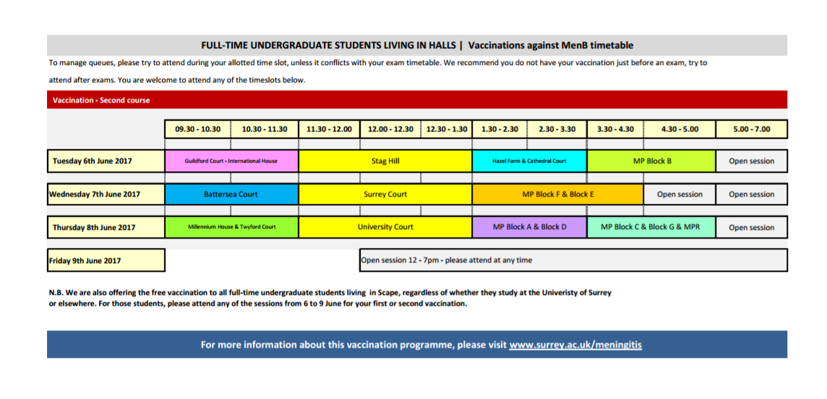
ACT NOW – Meningitis B vaccination programme

