Slide 1




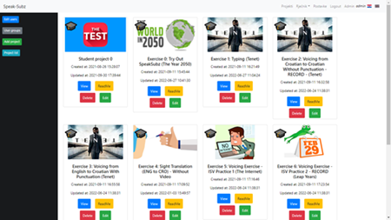
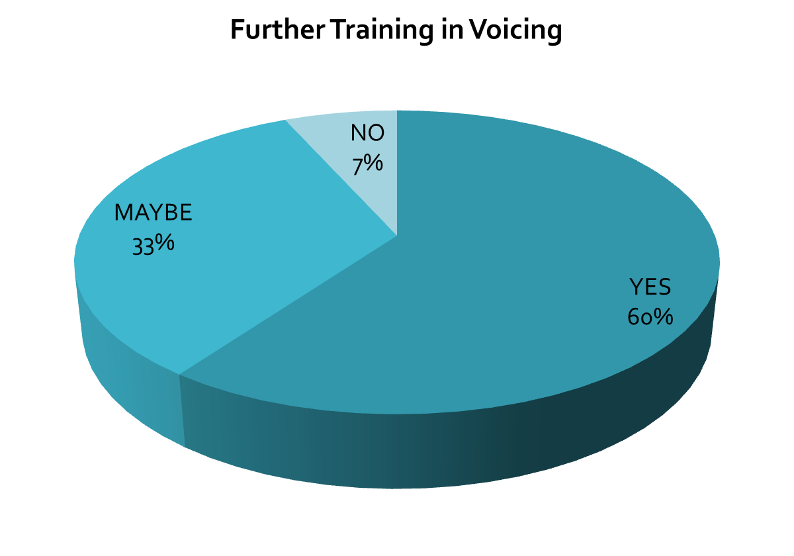
ISV - INTERLINGUAL SUBTITLE VOICING
ISV – A new technique for creating non-live subtitles through direct interaction with
speech recognition. Aims: increasing efficiency and enhancing the subtitler experience.
SELECTED
RESULTS
WHAT?
WHY?
HOW?
CROATIAN SR ACCURACY achieved by participants
using ISV calculated by the adapted NTR formula
used for live subtitling.
(Romero-Fresco & Pöchhacker, 2017)
RQ1: How does the technique influence efficiency intended as
speed (voicing versus typing)
and speech recognition
accuracy?
Need to improve efficiency and motivation by introducing variety
and handheld devices
into the workflow.
(Zapata Rojas, 2016)
8-9 hours specialised
ISV training (video tutorials,
8 exercises) (Dawson, 2020)
Pre- and post-training questionnaires
OVER 94 %
OVER 99 %
RQ2: In what way does the ISV influence the traditional subtitling workflow and the subtitler experience (SUBX)?
Need to improve mobility
and positively influence
physical and mental wellbeing.
Specialised voicing software integrated within the platform SpeakSubz
UNEDITED
EDITED
Delivery of experiment via methodological online hub
PARTICIPANTS' RECEPTION
PARTICIPANTS
15 experienced translators, predominantly subtitlers (13)
PhD Researcher: Željko Radić
Supervisory Team: Dr Elena Davitti & Prof Sabine Braun
REFERENCES
*Romero-Fresco, P., & Pöchhacker, F. (2017). Quality assessment in interlingual live subtitling: The NTR model. LinguisticaAntverpiensia, New Series: Themes in Translation Studies, 16, 149–167
*Rojas, J.Z. (2016). Translators in the Loop: Observing and Analyzing the Translator Experience with Multimodal Interfaces for Interactive Translation Dictation Environment Design. Doctoral thesis.
*Dawson. H. (2020) Interlingual live subtitling: a research-informed training model for interlingual respeakers to improve access for a wide audience. Doctoral thesis.

