Slide 1
Complex health challenges:
Learning disability and cancer care.
Association of Cancer Physicians / UKSMO Conference 2026
Natalie Gil
Research Fellow in Health Inequalities
& Trainee Health Psychologist
n.gil@surrey.ac.uk

Slide 2
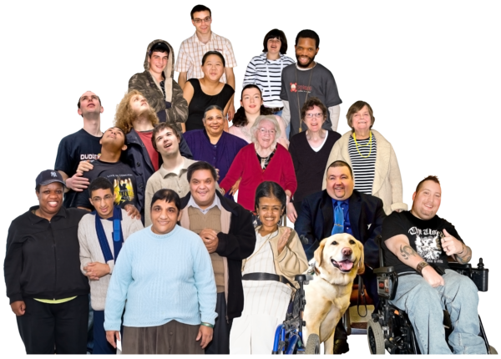
What do we mean by learning disability?
A heterogeneous population with different support needs
Lifelong condition affecting intellectual and adaptive functioning
Onset during the developmental period
Wide variation in communication, independence and support
Many people live independently
Some require high levels of support
ACP / UKSMO Annual Conference | April 2026
Notes:
The next step is to finalise the analysis of the advocate interviews and then bring together both perspectives for a fuller understanding.
From there I’ll move into writing up results and discussion.
I’ll also be working with the PPIE panel on how to share findings in accessible formats.
Looking back, recruitment was slow and difficult, but incredibly instructive.
PPIE was essential in the success of the research.
I’ll finish with a reflection: research with seldom-heard groups takes time and adaptation, but it is vital for addressing health inequalities.
As a takeaway, I would invite you all to think about how we, as a research community, can better embed accessible qualitative methods in all of our health research. As I so often hear in my work, if we get things right for people with intellectual disabilities, we get things right for everyone.

Slide 3
Wider health inequities in people with learning disability
LeDeR reviews consistently highlight missed opportunities in care
Median age of death ~20 years lower
Higher proportion of potentially avoidable deaths
Inequities are systemic rather than condition-specific
Often arise from the interaction between impairment and inaccessible systems
Cancer care reflects these broader patterns of inequity
ACP / UKSMO Annual Conference | April 2026
Notes:
The next step is to finalise the analysis of the advocate interviews and then bring together both perspectives for a fuller understanding.
From there I’ll move into writing up results and discussion.
I’ll also be working with the PPIE panel on how to share findings in accessible formats.
Looking back, recruitment was slow and difficult, but incredibly instructive.
PPIE was essential in the success of the research.
I’ll finish with a reflection: research with seldom-heard groups takes time and adaptation, but it is vital for addressing health inequalities.
As a takeaway, I would invite you all to think about how we, as a research community, can better embed accessible qualitative methods in all of our health research. As I so often hear in my work, if we get things right for people with intellectual disabilities, we get things right for everyone.

Slide 4

Inequity in cancer care
Cancer = 2nd leading cause of death for adults with a Learning Disability¹
More likely to be diagnosed via emergency presentation than any other route²
Inequity may arise across diagnosis, staging, treatment &/or support
Standard pathways are not neutral - they work better for some patients than others
ACP / UKSMO Annual Conference | April 2026

Slide 5
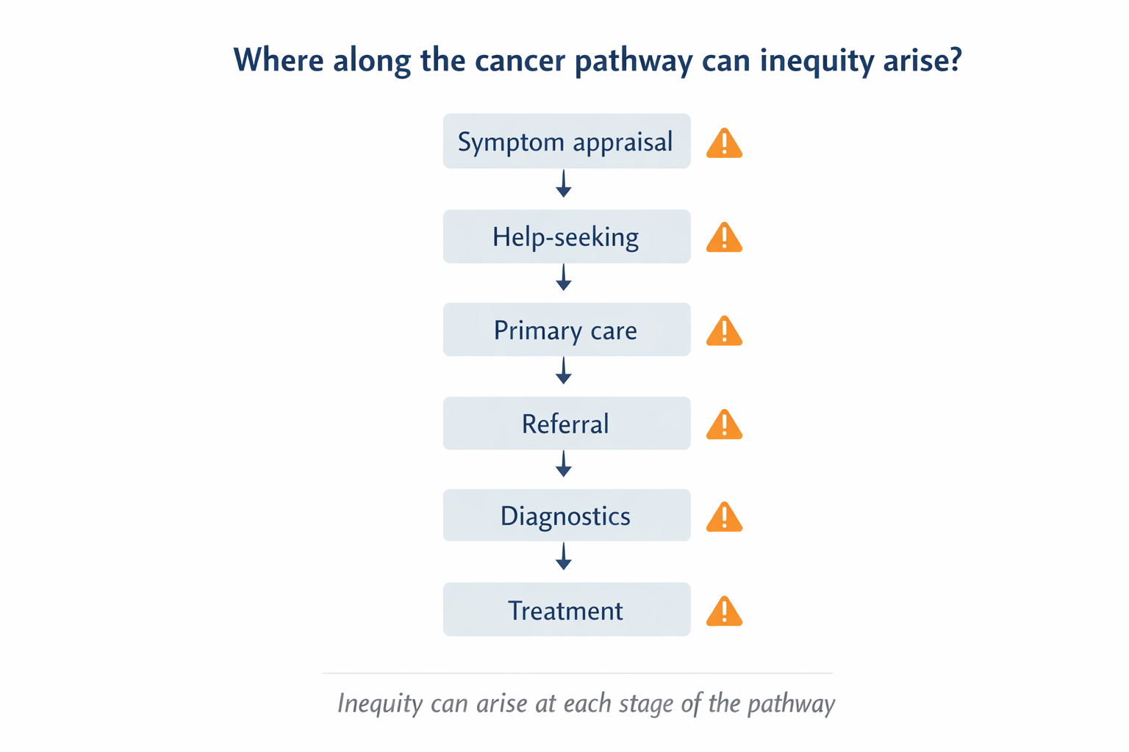
ACP / UKSMO Annual Conference | April 2026
Notes:
The next step is to finalise the analysis of the advocate interviews and then bring together both perspectives for a fuller understanding.
From there I’ll move into writing up results and discussion.
I’ll also be working with the PPIE panel on how to share findings in accessible formats.
Looking back, recruitment was slow and difficult, but incredibly instructive.
PPIE was essential in the success of the research.
I’ll finish with a reflection: research with seldom-heard groups takes time and adaptation, but it is vital for addressing health inequalities.
As a takeaway, I would invite you all to think about how we, as a research community, can better embed accessible qualitative methods in all of our health research. As I so often hear in my work, if we get things right for people with intellectual disabilities, we get things right for everyone.

Slide 6
Scoping Review
What is known about cancer risk-factor & symptom awareness in people with a learning disability?
Patient Interviews
How is cancer care pathway experienced by patients with a learning disability and supporters?
Population-based analysis of health records
Do inequities appear at population level?
Understanding inequity across the cancer pathway
ACP / UKSMO Annual Conference | April 2026
Notes:
The next step is to finalise the analysis of the advocate interviews and then bring together both perspectives for a fuller understanding.
From there I’ll move into writing up results and discussion.
I’ll also be working with the PPIE panel on how to share findings in accessible formats.
Looking back, recruitment was slow and difficult, but incredibly instructive.
PPIE was essential in the success of the research.
I’ll finish with a reflection: research with seldom-heard groups takes time and adaptation, but it is vital for addressing health inequalities.
As a takeaway, I would invite you all to think about how we, as a research community, can better embed accessible qualitative methods in all of our health research. As I so often hear in my work, if we get things right for people with intellectual disabilities, we get things right for everyone.

Slide 7
What THE LITERATURE SHOWED
Predominance of research in screening
Limited focus on symptomatic cancer diagnosis
Lack of theory or co-design in interventions to improve this
Gaps in understanding how inequity is produced
Low cancer awareness among people with learning disability
ACP / UKSMO Annual Conference | April 2026
Notes:
The next step is to finalise the analysis of the advocate interviews and then bring together both perspectives for a fuller understanding.
From there I’ll move into writing up results and discussion.
I’ll also be working with the PPIE panel on how to share findings in accessible formats.
Looking back, recruitment was slow and difficult, but incredibly instructive.
PPIE was essential in the success of the research.
I’ll finish with a reflection: research with seldom-heard groups takes time and adaptation, but it is vital for addressing health inequalities.
As a takeaway, I would invite you all to think about how we, as a research community, can better embed accessible qualitative methods in all of our health research. As I so often hear in my work, if we get things right for people with intellectual disabilities, we get things right for everyone.

Slide 8
What patients & supporters described
Barriers across the pathway reflected:
‘I’ve got a condition called neurofibromatosis and I should have yearly mammogram checks, but it was very difficult to get them to agree to do it, in the end they said yes and then that time they found something. ’
Stigma - concerns not always recognised or taken seriously
Diagnostic overshadowing - symptoms attributed to existing conditions
Advocated candidacy - access dependent on supporter persistence
Assumptions - about risk, lifestyle, tolerance, and quality of life
Pathway inflexibility
difficulty adapting diagnostics and care
‘I was seeing double vision. I knew something wasn’t right. It took two days for them to listen, they decided to take me for a scan, that’s when they found the tumour. By that time, it hit my optic nerve, that’s why I was seeing double.’
‘Someone with a severe learning disability, but a fantastic carer, has got a better chance of accessing a decent level of healthcare, than a person with a mild learning disability who doesn’t have anyone to advocate for them & is easily brushed off’
ACP / UKSMO Annual Conference | April 2026
Notes:
The next step is to finalise the analysis of the advocate interviews and then bring together both perspectives for a fuller understanding.
From there I’ll move into writing up results and discussion.
I’ll also be working with the PPIE panel on how to share findings in accessible formats.
Looking back, recruitment was slow and difficult, but incredibly instructive.
PPIE was essential in the success of the research.
I’ll finish with a reflection: research with seldom-heard groups takes time and adaptation, but it is vital for addressing health inequalities.
As a takeaway, I would invite you all to think about how we, as a research community, can better embed accessible qualitative methods in all of our health research. As I so often hear in my work, if we get things right for people with intellectual disabilities, we get things right for everyone.

Slide 9
What patients & supporters described
‘I had a lady that holds my hand and she talks to me, she says, “Come on, you don’t have to be frightened”. I’m still scared of it. I don’t think I’m going to ever not going to be scared..’
Compassionate, flexible care made the difference
💬 Took concerns seriously
🕒 Allowed additional time
🗣 Adapted communication
👥 Involved supporters
🔗 Coordinated care
⚖ Avoided assumptions
🔄 Flexible pathways
‘And what I love about my doctor is he lets me talk first, then he lets my support worker or my key worker talk, and then he talks afterwards’
‘They explain it in a way I can understand & then they show me all the equipment first, what they are going to do & what’s going to happen after.’
ACP / UKSMO Annual Conference | April 2026
Notes:
The next step is to finalise the analysis of the advocate interviews and then bring together both perspectives for a fuller understanding.
From there I’ll move into writing up results and discussion.
I’ll also be working with the PPIE panel on how to share findings in accessible formats.
Looking back, recruitment was slow and difficult, but incredibly instructive.
PPIE was essential in the success of the research.
I’ll finish with a reflection: research with seldom-heard groups takes time and adaptation, but it is vital for addressing health inequalities.
As a takeaway, I would invite you all to think about how we, as a research community, can better embed accessible qualitative methods in all of our health research. As I so often hear in my work, if we get things right for people with intellectual disabilities, we get things right for everyone.

Slide 10
Two Distinct Risk Patterns
Mild/Borderline LD
LD may not be recorded in health records
Severe/Profound LD
greater risk of assumptions about tolerability
may lack strong, consistent advocacy
may “mask” or appear “coping” while struggling
may not communicate symptoms clearly enough to be fully heard
quality-of-life judgements may shape decisions
consent/capacity processes may be mishandled
higher risk of therapeutic nihilism or over-protection
treatment may be withheld or narrowed on assumption rather than individual assessment
may not meet thresholds for services
ACP / UKSMO Annual Conference | April 2026
Notes:
The next step is to finalise the analysis of the advocate interviews and then bring together both perspectives for a fuller understanding.
From there I’ll move into writing up results and discussion.
I’ll also be working with the PPIE panel on how to share findings in accessible formats.
Looking back, recruitment was slow and difficult, but incredibly instructive.
PPIE was essential in the success of the research.
I’ll finish with a reflection: research with seldom-heard groups takes time and adaptation, but it is vital for addressing health inequalities.
As a takeaway, I would invite you all to think about how we, as a research community, can better embed accessible qualitative methods in all of our health research. As I so often hear in my work, if we get things right for people with intellectual disabilities, we get things right for everyone.

Slide 11
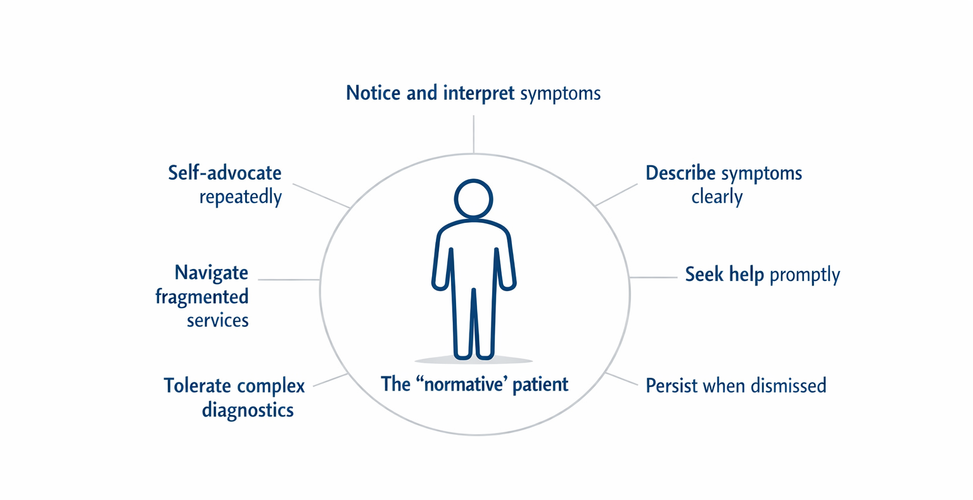
Care pathways privilege “normative patients”
ACP / UKSMO Annual Conference | April 2026
Notes:
The next step is to finalise the analysis of the advocate interviews and then bring together both perspectives for a fuller understanding.
From there I’ll move into writing up results and discussion.
I’ll also be working with the PPIE panel on how to share findings in accessible formats.
Looking back, recruitment was slow and difficult, but incredibly instructive.
PPIE was essential in the success of the research.
I’ll finish with a reflection: research with seldom-heard groups takes time and adaptation, but it is vital for addressing health inequalities.
As a takeaway, I would invite you all to think about how we, as a research community, can better embed accessible qualitative methods in all of our health research. As I so often hear in my work, if we get things right for people with intellectual disabilities, we get things right for everyone.

Slide 12
Pathway expects vs patient’s actual needs
Fast symptom articulation
Clear communication
Independent navigation
Standard appointments
Reasonable adjustments e.g.
- Extra appointment time
- Alternate / Augmented Communication
Co-ordinated support
ACP / UKSMO Annual Conference | April 2026
Notes:
The next step is to finalise the analysis of the advocate interviews and then bring together both perspectives for a fuller understanding.
From there I’ll move into writing up results and discussion.
I’ll also be working with the PPIE panel on how to share findings in accessible formats.
Looking back, recruitment was slow and difficult, but incredibly instructive.
PPIE was essential in the success of the research.
I’ll finish with a reflection: research with seldom-heard groups takes time and adaptation, but it is vital for addressing health inequalities.
As a takeaway, I would invite you all to think about how we, as a research community, can better embed accessible qualitative methods in all of our health research. As I so often hear in my work, if we get things right for people with intellectual disabilities, we get things right for everyone.

Slide 13
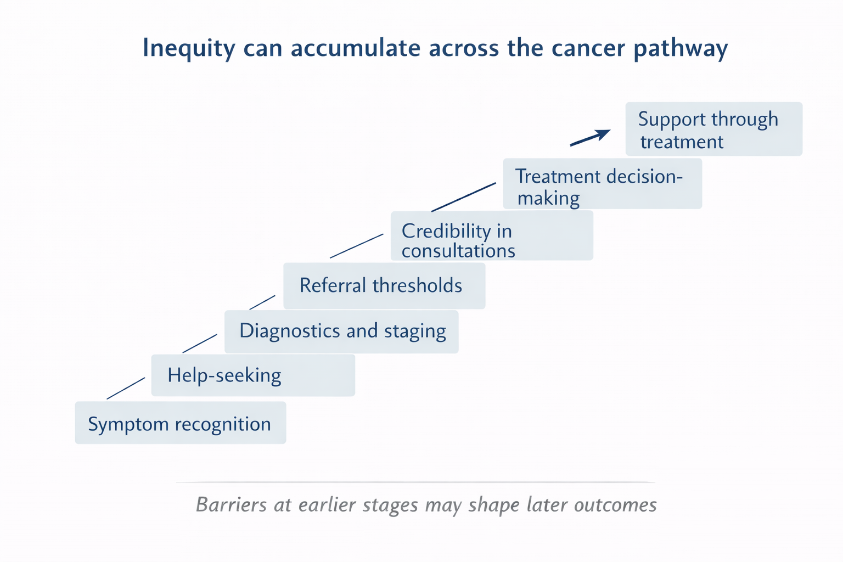
ACP / UKSMO Annual Conference | April 2026
Notes:
The next step is to finalise the analysis of the advocate interviews and then bring together both perspectives for a fuller understanding.
From there I’ll move into writing up results and discussion.
I’ll also be working with the PPIE panel on how to share findings in accessible formats.
Looking back, recruitment was slow and difficult, but incredibly instructive.
PPIE was essential in the success of the research.
I’ll finish with a reflection: research with seldom-heard groups takes time and adaptation, but it is vital for addressing health inequalities.
As a takeaway, I would invite you all to think about how we, as a research community, can better embed accessible qualitative methods in all of our health research. As I so often hear in my work, if we get things right for people with intellectual disabilities, we get things right for everyone.

Slide 14
Population-level findings
These inequities are not just anecdotal
Just 0.5% of sample had a recorded learning disability
  Meaning just 18-25% of PwLD are recorded in health records³
More adverse stage/route patterns were seen for people with learning disability
Colorectal cancer showed the clearest evidence of diagnostic inequity
  Younger age at onset (below screening age)
  Less Urgent Suspected Cancer referrals
  Higher odds of emergency presentation
  Evidence of compounded inequity by deprivation
Breast cancer showed more unstaged cancers rather than a simple stage IV pattern
  Indicating metastatic, cancer of unknown primary, or inequity in diagnostic work-up
ACP / UKSMO Annual Conference | April 2026
Notes:
The next step is to finalise the analysis of the advocate interviews and then bring together both perspectives for a fuller understanding.
From there I’ll move into writing up results and discussion.
I’ll also be working with the PPIE panel on how to share findings in accessible formats.
Looking back, recruitment was slow and difficult, but incredibly instructive.
PPIE was essential in the success of the research.
I’ll finish with a reflection: research with seldom-heard groups takes time and adaptation, but it is vital for addressing health inequalities.
As a takeaway, I would invite you all to think about how we, as a research community, can better embed accessible qualitative methods in all of our health research. As I so often hear in my work, if we get things right for people with intellectual disabilities, we get things right for everyone.

Slide 15
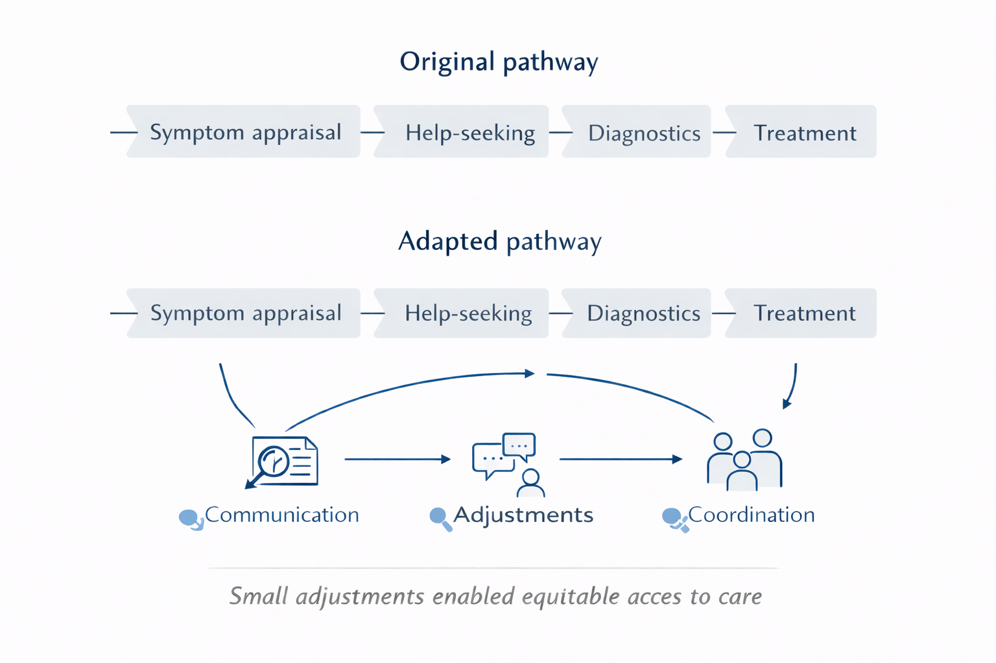
Service-level implications
Improving pathways for people with a learning disability
Record and use reasonable adjustments
Provide accessible information
Improve co-ordination across services
Anticipate support needs through diagnostics & treatment
Recognise and reduce reliance on exceptional advocacy
ACP / UKSMO Annual Conference | April 2026
Notes:
The next step is to finalise the analysis of the advocate interviews and then bring together both perspectives for a fuller understanding.
From there I’ll move into writing up results and discussion.
I’ll also be working with the PPIE panel on how to share findings in accessible formats.
Looking back, recruitment was slow and difficult, but incredibly instructive.
PPIE was essential in the success of the research.
I’ll finish with a reflection: research with seldom-heard groups takes time and adaptation, but it is vital for addressing health inequalities.
As a takeaway, I would invite you all to think about how we, as a research community, can better embed accessible qualitative methods in all of our health research. As I so often hear in my work, if we get things right for people with intellectual disabilities, we get things right for everyone.

Slide 16



Thank you for listening!
@NatalieMariaNg
Natalie-gil19
n.gil@surrey.ac.uk
Acknowledgements
Participants & PPIE
Dr Robert Kerrison
Dr Anna Cox
Professor Katriina Whitaker
Clinical Supervision: Dr Emily McBride
ACP / UKSMO Annual Conference | April 2026

Slide 17
References
Landes, S.D., J.D. Stevens, and M.A. Turk, Cause of death in adults with intellectual disability in the United States. Journal of Intellectual Disability Research, 2021. 65(1): p. 47-59.
Heslop, P., et al., Cancer in deceased adults with intellectual disabilities: English population-based study using linked data from three sources. BMJ open, 2022. 12(3): p. e056974
Shemtob, L., Ramanathan, R., & Courtenay, K. Learning disability registers: known unknowns and unknown unknowns. BJGP, 2021. 71(705): 153-154.
ACP / UKSMO Annual Conference | April 2026

