Slide 1




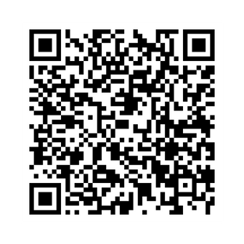





Co-creating a health survey with people
with a learning disability
Dr Mar Estupiñán [1], Dr Esra Hassan [1], Dr Arsene Hobabagabo [1], Dr Claire Friedemann Smith [2], Prof Christian Von Wagner [3], Dr Anna Cox [1], Dr Robert S Kerrison [1] , Prof Katriina L Whitaker [1]
Affiliations: [1] University of Surrey, [2] University of Oxford, [3] University College London
Why we did this?
  Health services ask people to fill out surveys to learn what they like and need.
  Sometimes, these surveys don’t include people with a learning disability.
  This means that services might not meet everyone’s needs.
  We wanted to work together to make a new survey, so that people with a learning disability are heard.
How are we doing this?
We looked for all the surveys that already exist, asking people about things like noticing changes in their body and their experiences of going to the doctor.
We looked at whether these had been designed with and for people with a learning disability.
  Now, we are working together with experts (by profession or experience) to build a new survey.
  We will ask a group of people with a learning disability to complete the survey and tell us how can we improve it.
  Then, we will share the survey with healthcare staff to complete with people with a learning disability to learn if it can make a difference.
What will we recommend?
  Future healthcare surveys should use questions that include everyone.
  People who make decisions and staff can use our new survey to make care fairer and better for all.
How can you find out more?
You can email:
Mar Estupiñán at m.estupinan@surrey.ac.uk
Katriina L Whitaker at k.whitaker@surrey.ac.uk

