Slide 1


Inclusive research to understand earlier cancer diagnosis for people with a learning disability
Notes:
Jess
Hello my name is Lizzie. I’m a researcher from the University of Surrey
Hello my name is Jess. I’m a researcher from Queen Mary University of London
And we are here today to speak about the CancerLearn project, which aims to improve earlier cancer diagnosis for people with a learning disability
We have been using an inclusive approach throughout our work so far which we would like to share with you today

Slide 2
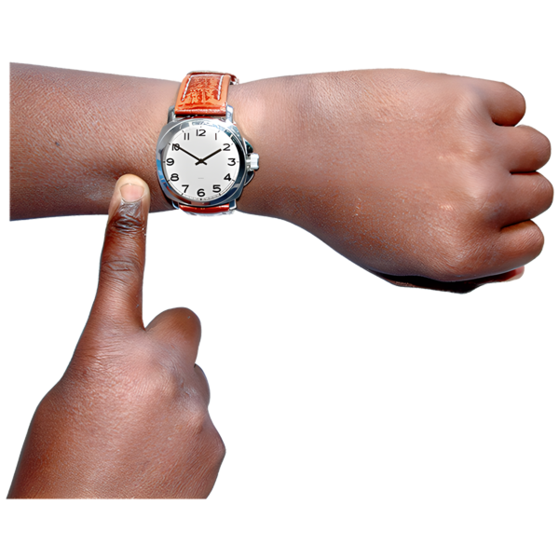

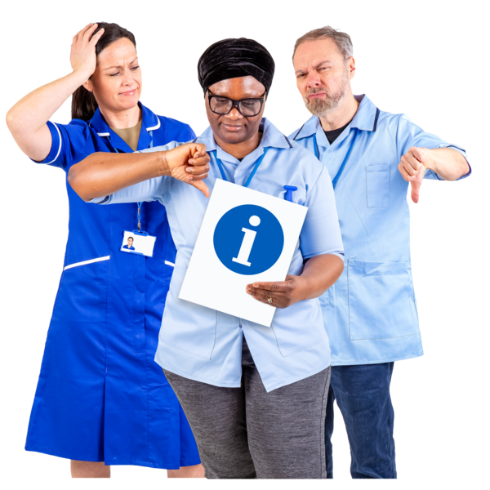
What is the project about?
People with a learning disability are not diagnosed with cancer as quickly as people without a learning disability.
This means that by the time they are diagnosed their cancer is more advanced and harder to treat.
We do not have a lot of information about what happens when learning disabled people have symptoms (that could be cancer related).
Notes:
Lizzie

Slide 3
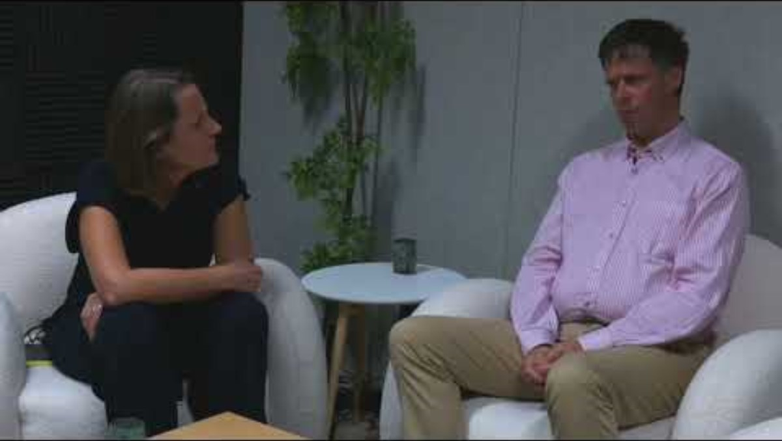
Scott Watkin is an expert by experience.
Here, he talks about why the project is so important
Notes:
Lizzie
We wanted to share an audio clip of Scott Watkin, who is an expert by experience, and has been involved in the project since the start.
He speaks about the inequalities people with a learning disability experience, from symptoms not being listened to by those providing care and support and services not being accessible. All these lead to the differences we see in cancer diagnosis and outcomes for learning disabled people.

Slide 4
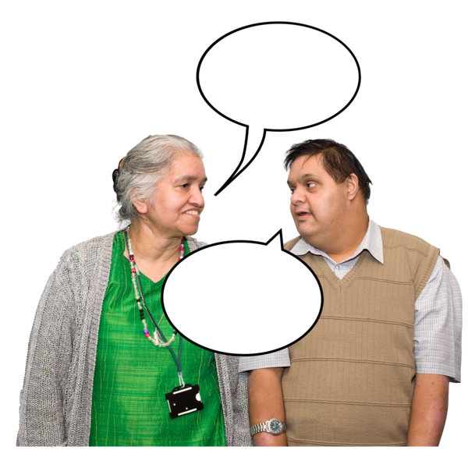
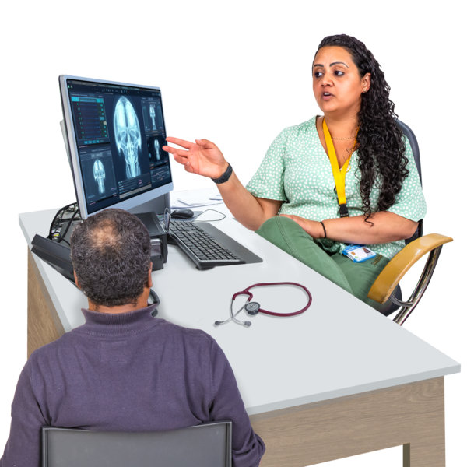
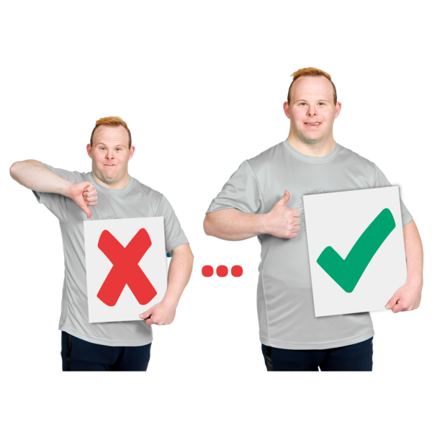
What are we going to do?
Speak to learning disabled people (and the people supporting them) to find out more.
We want to know about the journey from noticing a symptom and seeking help, to how the symptom was managed by the health care system.
We want to know what helped and what could be done to make it better.
Notes:
Jess
As part of the project, we are speaking to people with a learning disability and those who support them if they have had a medical symptom investigated. We aim to speak to people about the journey from noticing a symptom to seeking help and how the symptom was managed by the healthcare system. We want to know what helped and what could have been done to make it better.

Slide 5
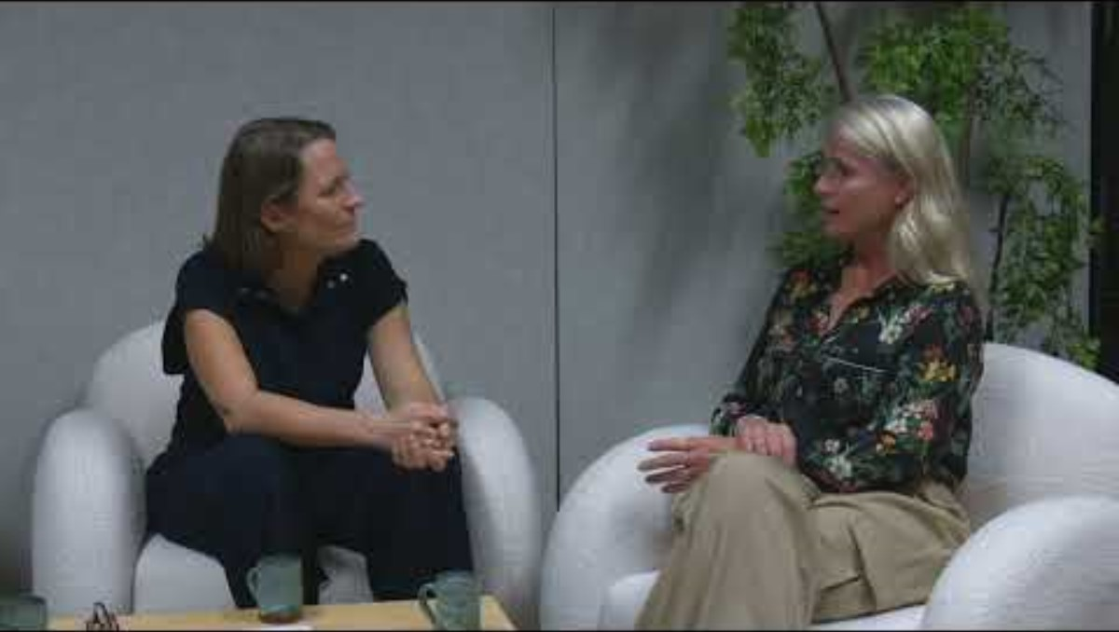
Helen Guest is Co-production and Engagement Manager at Active Prospects.
Here, she talks about the value of lived experience in research
Notes:
Jess
The OPTIMISE project, led by Victoria Shepard at Cardiff University aims to develop guidelines for inclusive research in clinical trials however it can be applied to all research. One of the guiding principles is COLLABORATION. In this clip, Helen Guest, our co-production and engagement manager, speaks about the value of lived experience in research.

Slide 6
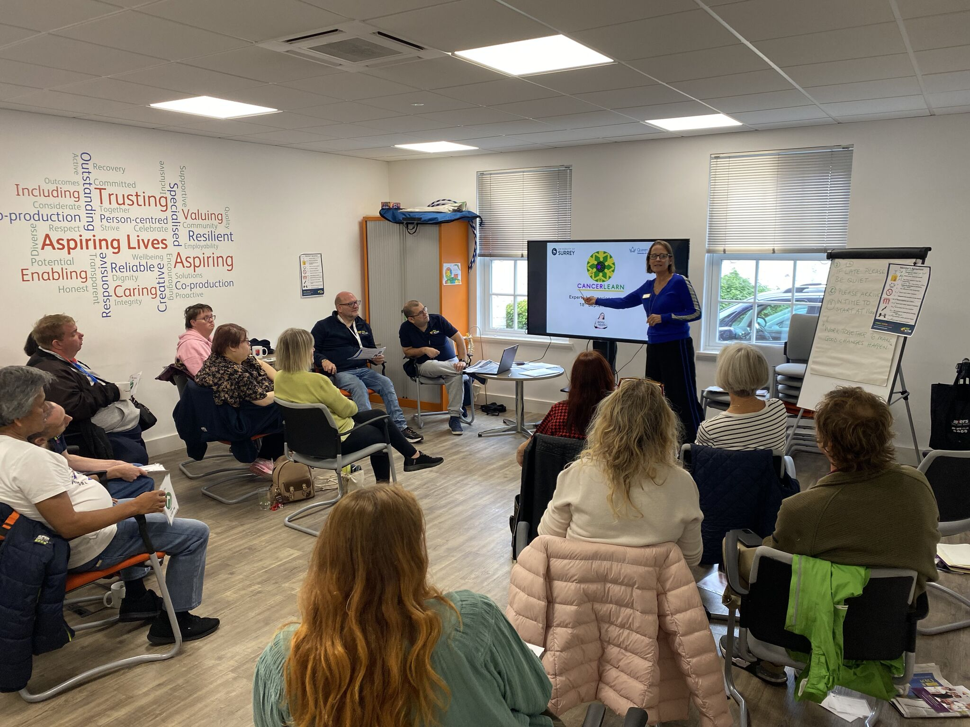
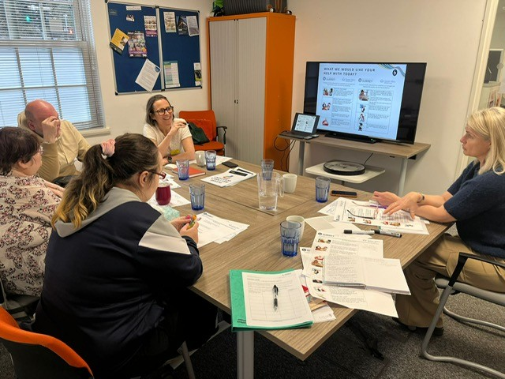
Collaborating with experts by experience
Notes:
Lizzie
We’ve worked closely with our Patient and Public Involvement partners throughout the study, from co-designing the logo to shaping accessible participant materials to identifying key areas for research. Most recently, experts by experience guided us on sensitive recruitment strategies for the study, recommending a gradual opt-in approach for our participants and clearer language around consent. Their feedback has really ensured that our methods are both considerate and effective in reaching participants.

Slide 7
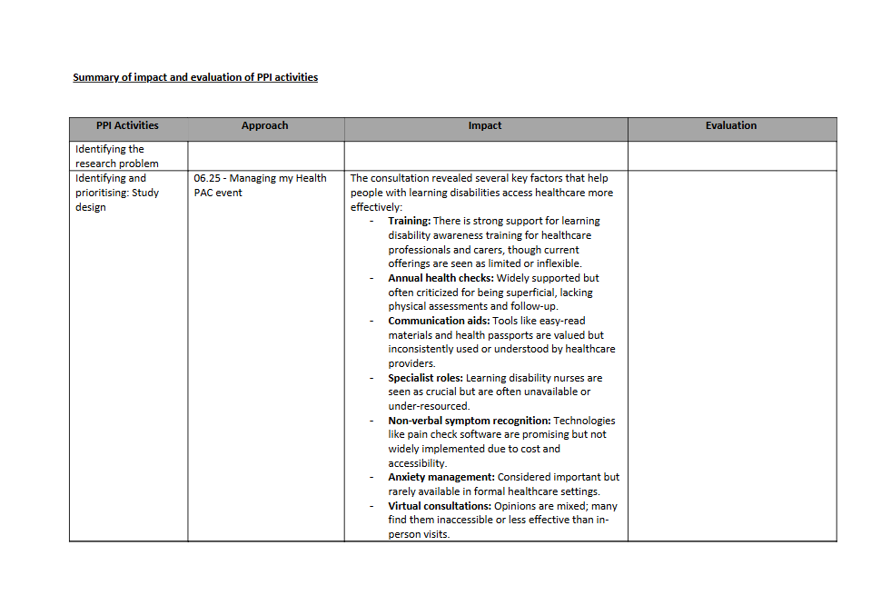
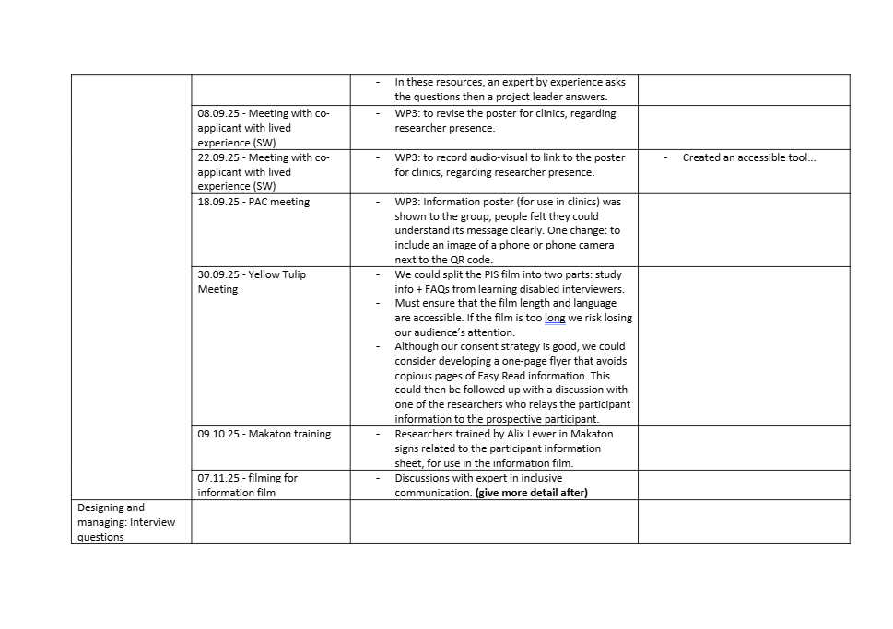
Tracking all the feedback we get and its impact on the project
Notes:
Lizzie
To make sure the feedback we collect from experts by experience really shapes our work, we created a simple tracking document that logs every meeting, the feedback received, and the actions we commit to. It’s sometimes easy to assume that listening is enough, but this process makes the impact of our patient and public involvement clear and tangible. Charting these changes has helped us hold ourselves accountable - and if you don’t already have something similar, it’s a tool I’d highly recommend.

Slide 8
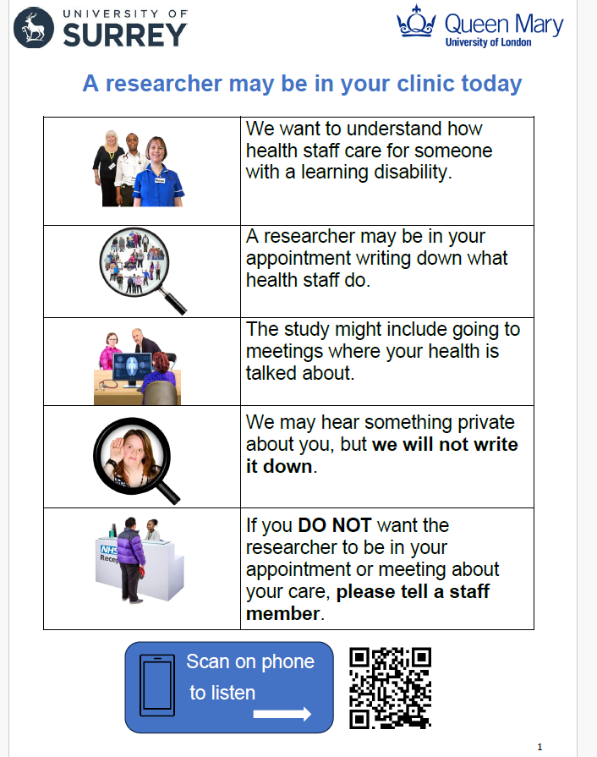
How will we tell people about the study?
We have made an information sheet that uses easy read images.
There is an audio version too.
Notes:
Jess
Here is an example our study documentation which has been co-produced with experts by experience. We have considered the FORMAT of participant information material, so as you can see we have used easy read with limited text and pictures. We also include the option of audio versions of the information which is read allowed by a person with a learning disability. Having multiple options available for providing information and seeking consent ensures that communication options can be tailored to the needs of the individual.

Slide 9
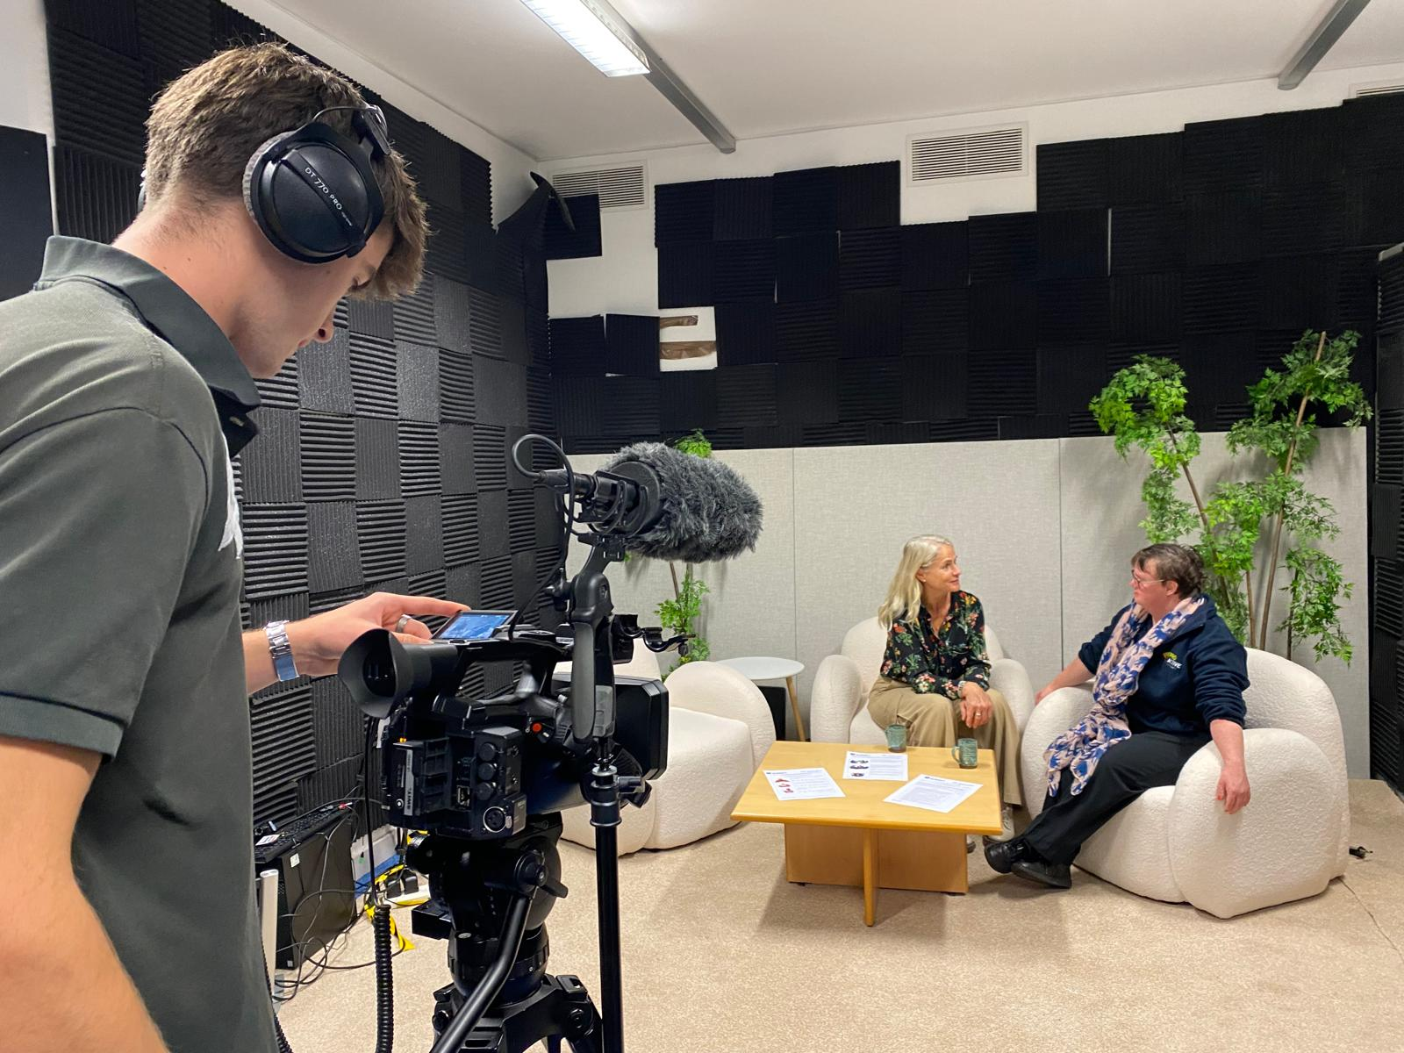
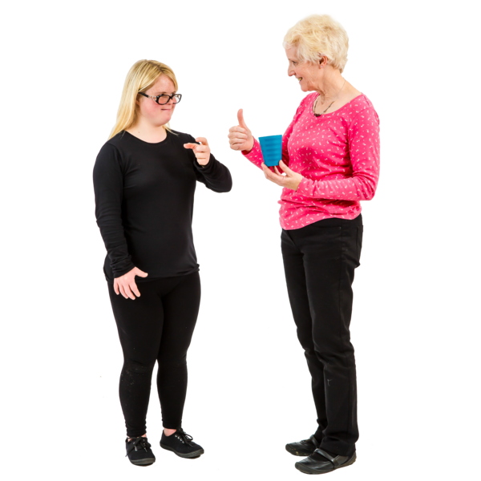
We have also made a film.
In the film, researchers answer questions from the information sheet.
Learning disabled people ask the questions.
The researchers in the film use Makaton (a way of signing and speaking).​
Notes:
Lizzie
Alongside our written information sheet, we co-produced an information film with people who have learning disabilities. We wanted to offer multiple formats so recruitment could be tailored to individual's communication needs. Additionally, as we plan to have healthcare professionals supporting our recruitment, this film helps to support them to share information about the study in an engaging way.
In the film, Jess and I answer their questions, using Makaton signing to make the content more accessible. This not only supported our interviewers and audiences but also created a real connection—one interviewer even taught us additional signs. It helped us slow down, think carefully about what we were communicating, and find simpler, clearer ways to share information.

Slide 10
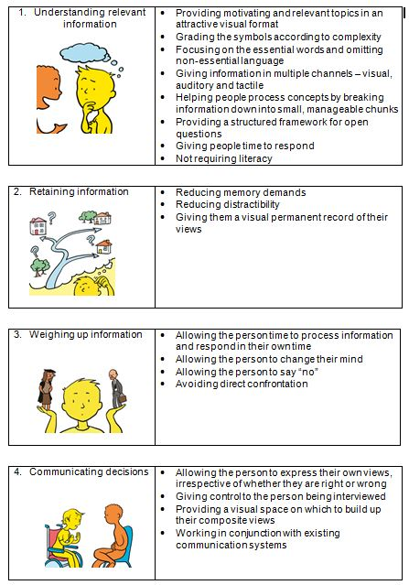
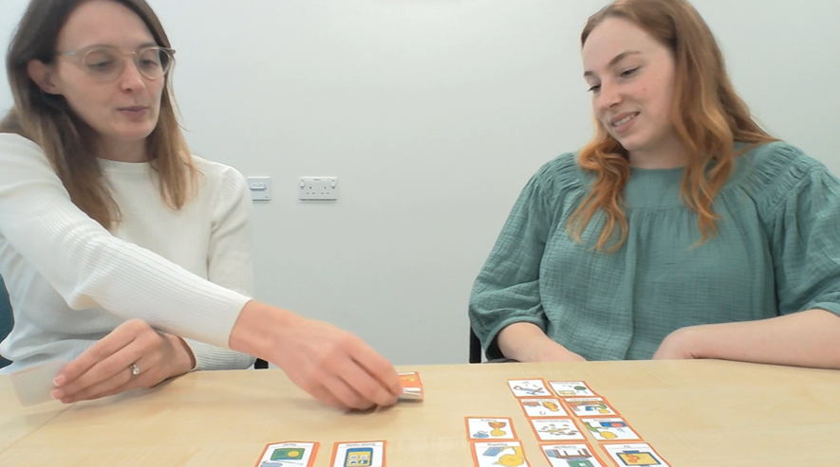
How will we support involvement?
We will use “talking mats” to help people decide if they want to take part, and for the interview.
Notes:
Jess
We acknowledge and have been told that conducting research with learning disabled people is all about trust and relationships. To continue to support involvement, Lizzie and I have been trained in Talking Mats which is a picture based communication tool. We have developed our own process for consent and the interview with a person with learning disabilities. Having a visual symbol supports the layering of information for learning disabled people. We have had positive feedback from people with lived experience on the use of these mats, especially with the ability to change the position of the symbols at the end which encourages empowerment and ownership.

Slide 11
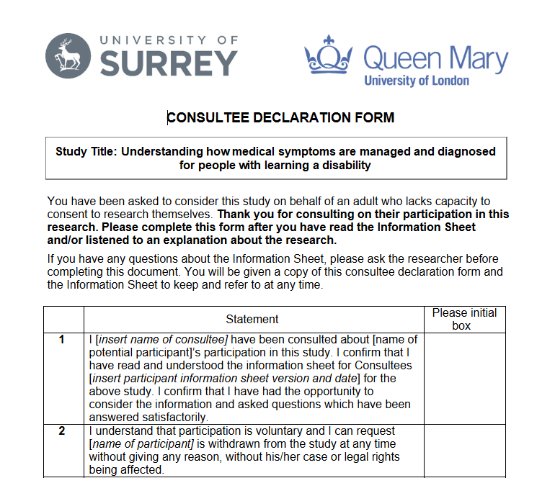
Including People with Profound Learning Disabilities in Research
We have a consultee process for taking part.
It is for people who cannot consent to taking part in research.
It means their feelings and experiences can still be included.
Notes:
Jess
We are including all adults with a learning disability in our research. We will always assume everyone has the capacity to consent to research (in line with the Mental Capacity Act 2005) however if someone cannot agree to take part themselves, we will ask someone else to help make that decision. This is called asking a ‘consultee’ which can be a Family member (personal) paid carer (nominated). We ask them, if the person did have capacity, what in their opinion would be their wish/preference about taking part. The consultee will then sign a form with this decision. We have presented our consultee process to learning disability research group, where we spoke about the importance of language in this process, especially the word consent/capacity, that someone is not consenting on their behalf but advising on a persons decision if they did have capacity.

Slide 12
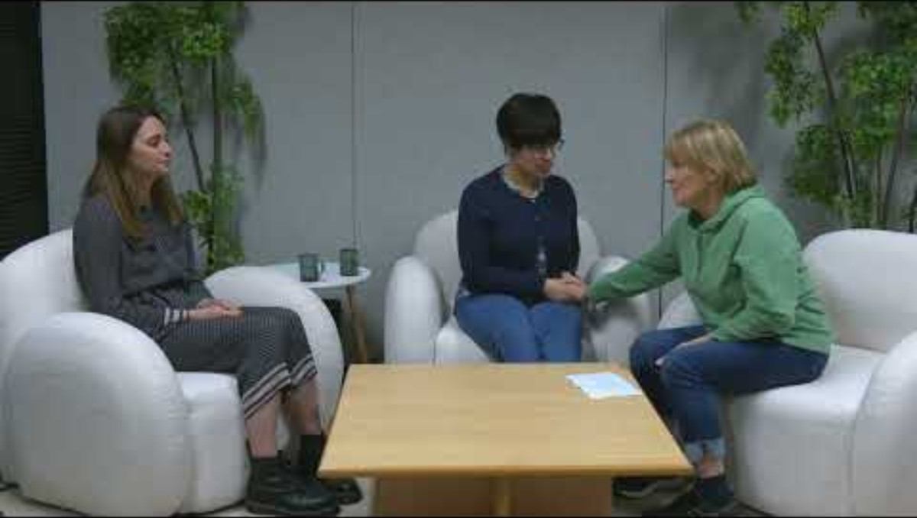
Why this is so important
Wendy supports her daughter, Lucia, who has a learning disability.
Wendy explains why it is important to help people take part in our research.
Notes:
Lizzie-
In this clip, Wendy, who supports her daughter Lucia, talks about the importance of Lucia's perspective being included in research.

Slide 13


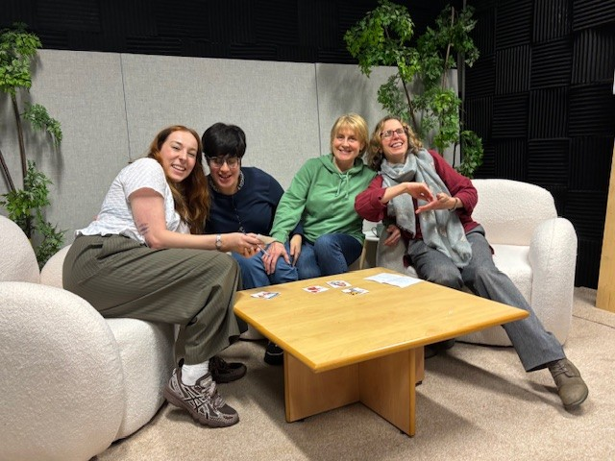
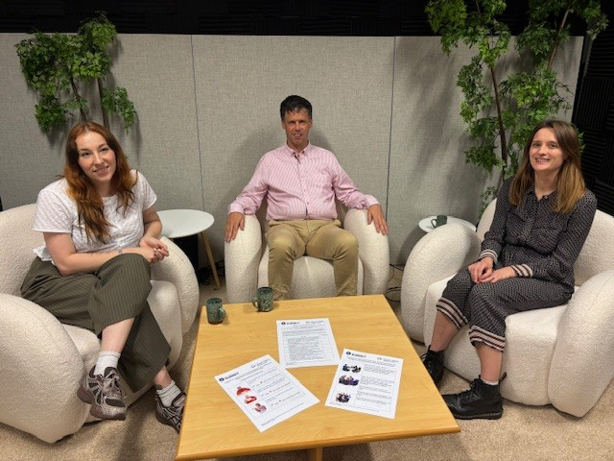
Our Inclusive Partners
Notes:
Jess
Our approach is guided by the advice we have received from our partner organisations. During our filming day, and our collaboration with INCLUDE we recognise the importance of continuing to involve the person with a learning disability even if a consultee is involved. It was recommended we use talking mats (as you can see on the table here) to include Lucia in the conversation, even if her mother was verbally responding to the questions. We had the impact of building relationships, rapport and a sense of connection, and lead to positive feedback being provided by participants in the filming day.

Slide 14
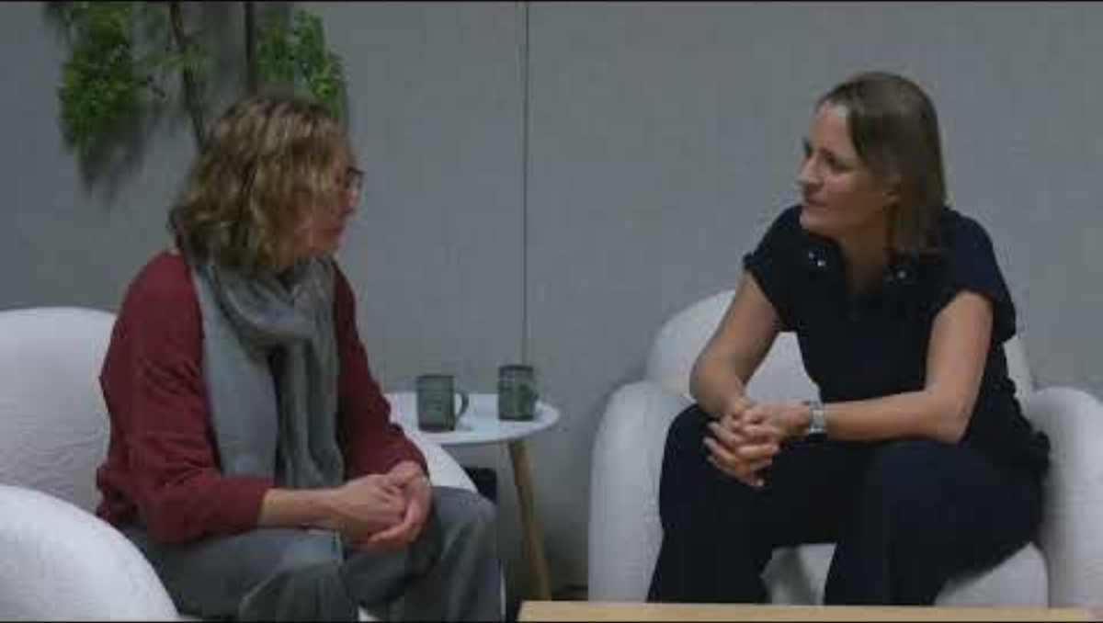
A message from one of our partners
Alix Lewer is the CEO of a charity that supports inclusion.
Notes:
Here is Alex, CEO of the charity INCLUDE which support inclusion (and also provided our Makaton taster session).

Slide 15
Q&A
We are happy to answer your questions.
We also want to learn from you.
Please tell us:
What ways of including people have worked well for you before?
Has your team tried anything that you would not do again?
Notes:
S

