Slide 1


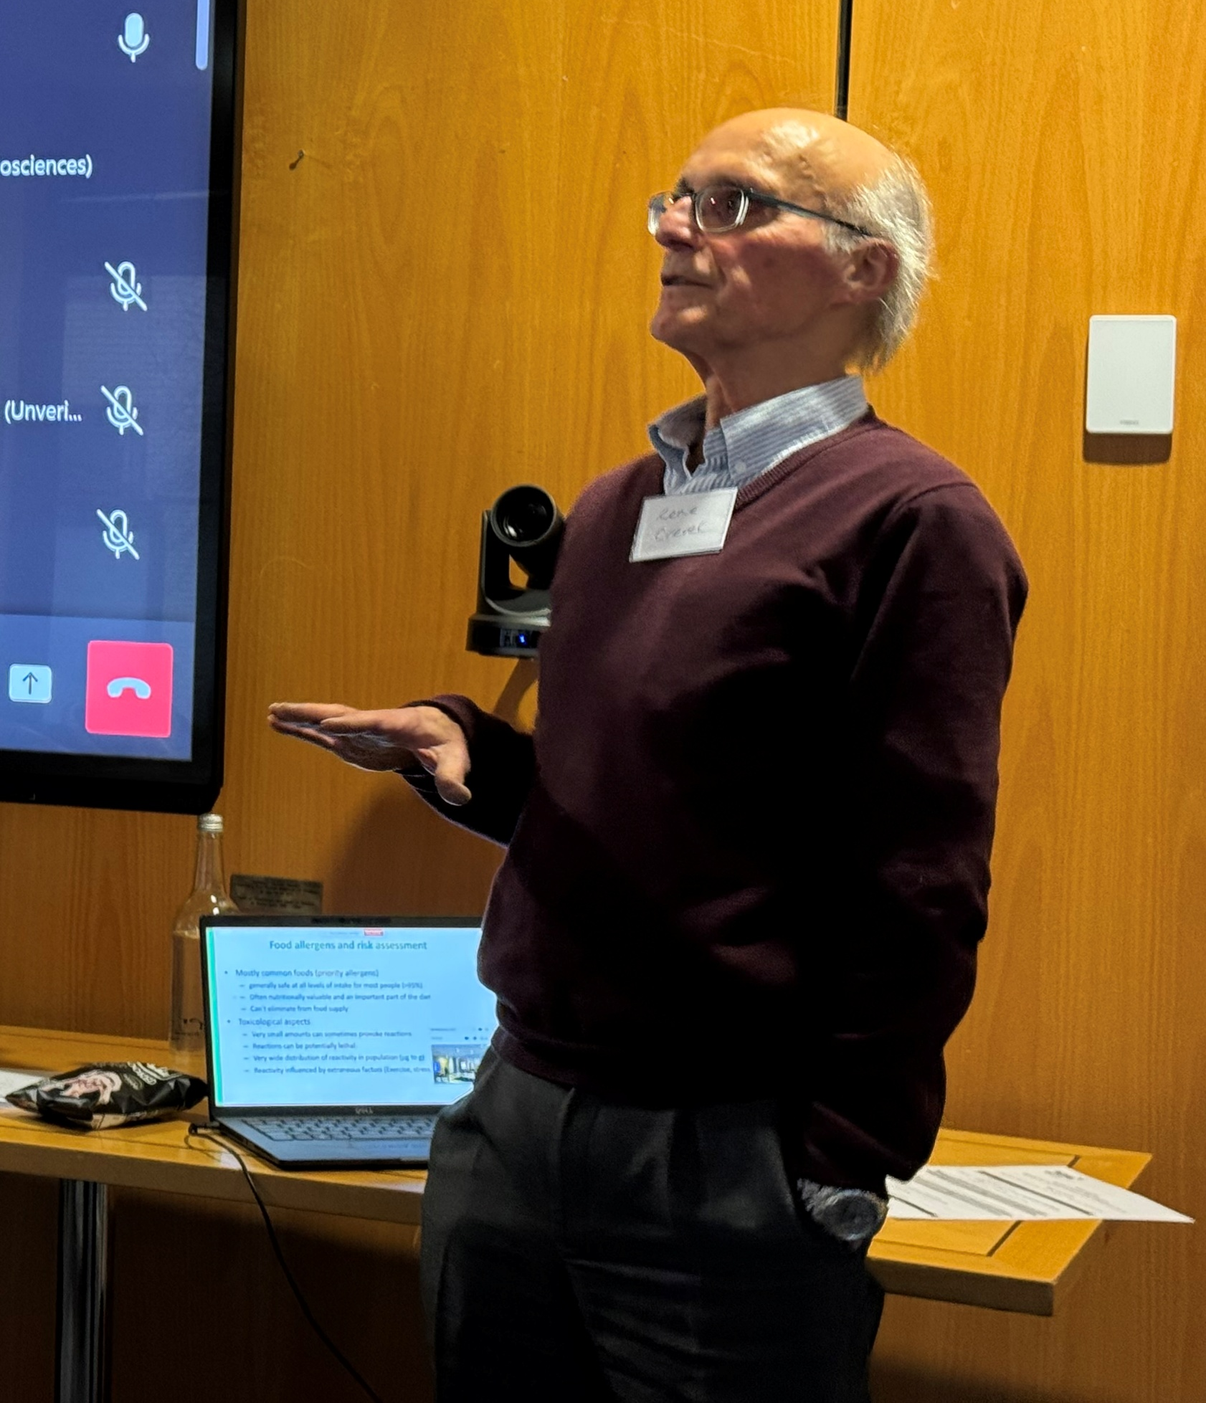
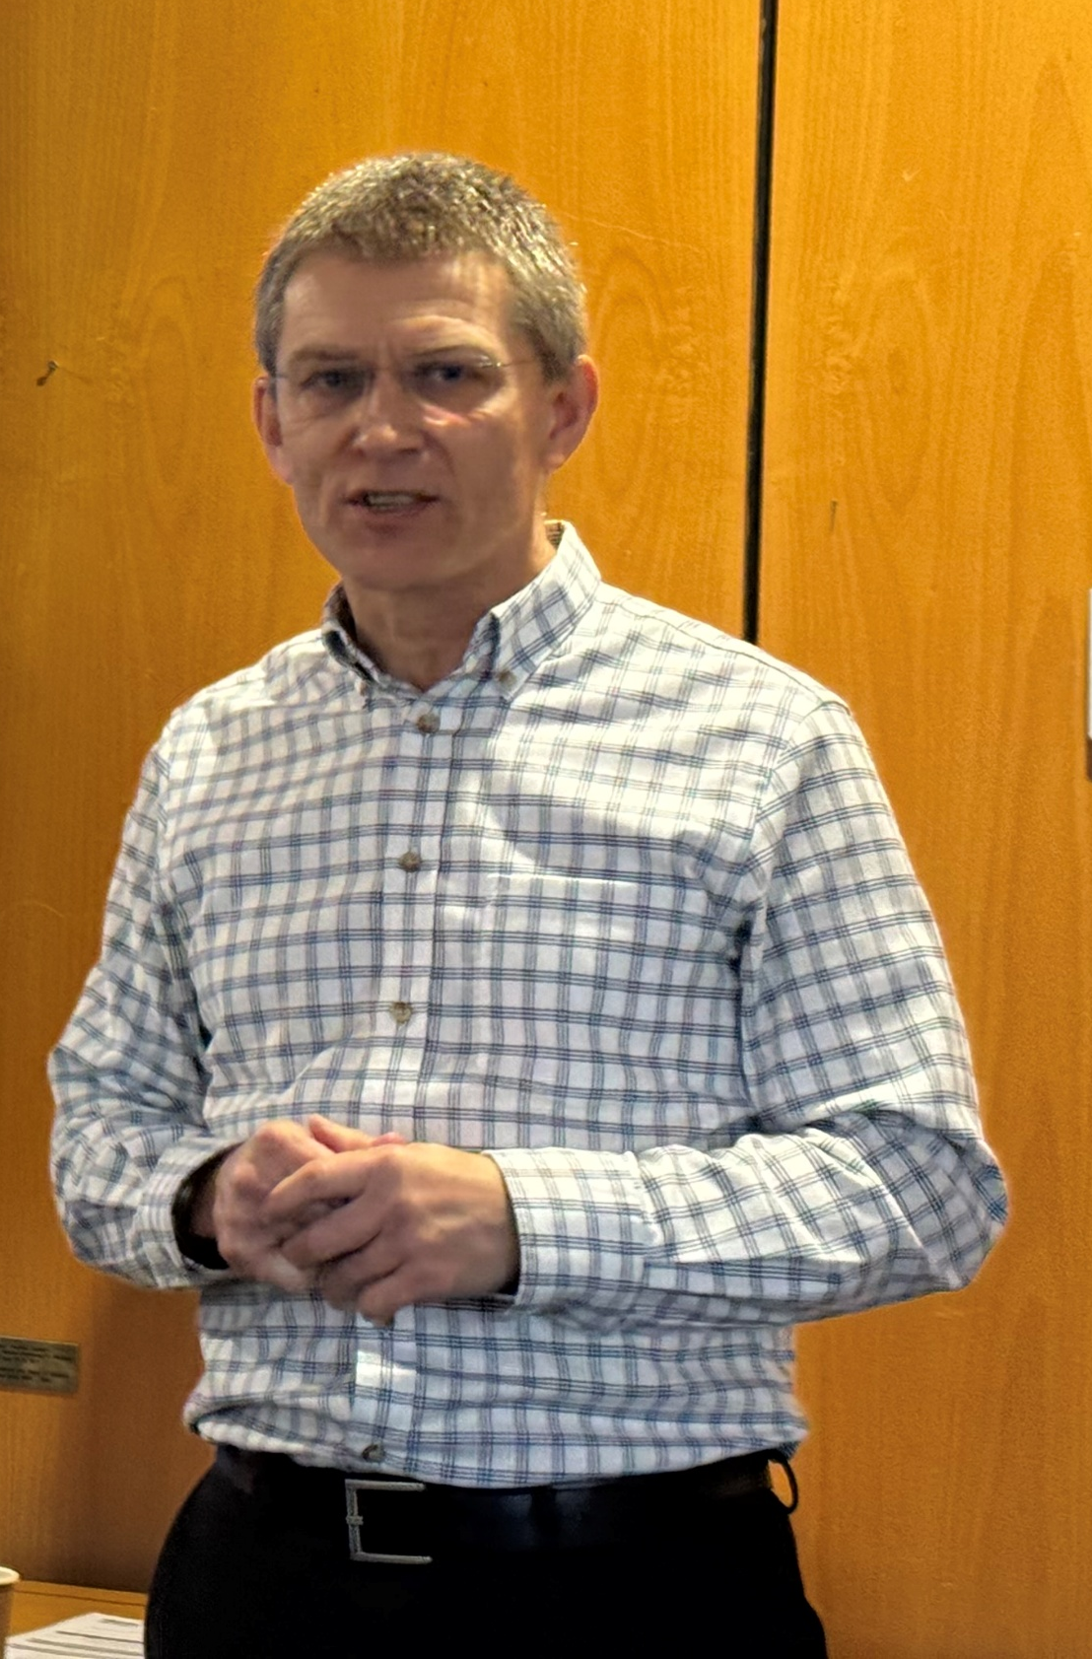
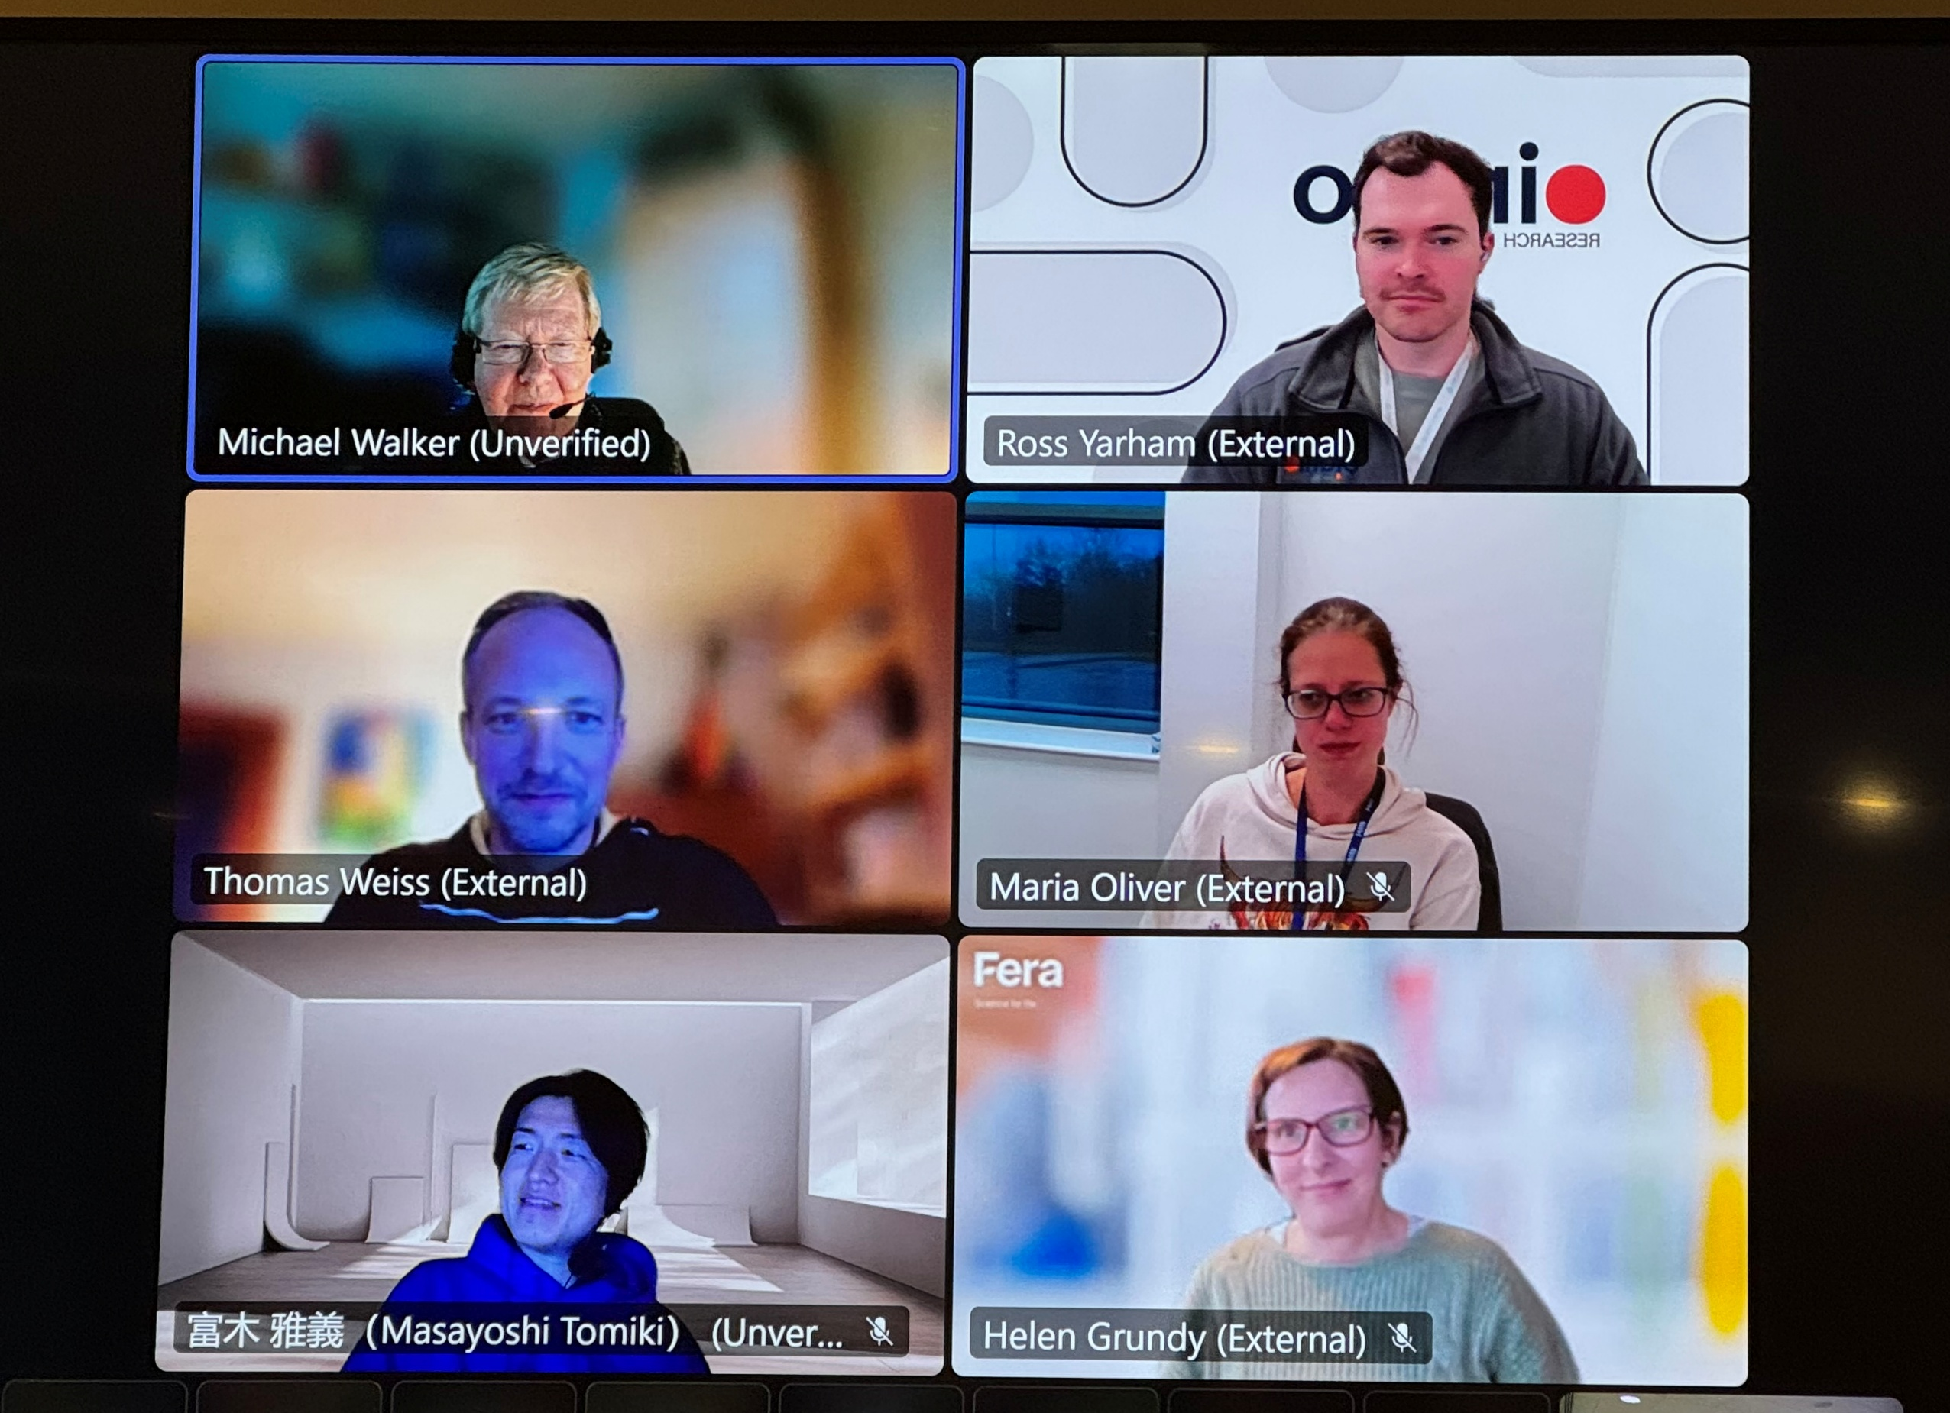
8th January 2026
‘Qualitative Risk Assessment of Food Allergens - where does analysis fit in?’
With 37 delegates in person and on-line from the UK, Australia, Germany, Denmark, Belgium and Japan delegates heard from John Figgins from BRCGS about ”Private standards and food allergen management “ and Rene Crevel on “Setting analysis in a risk assessment context”.

