Slide 1


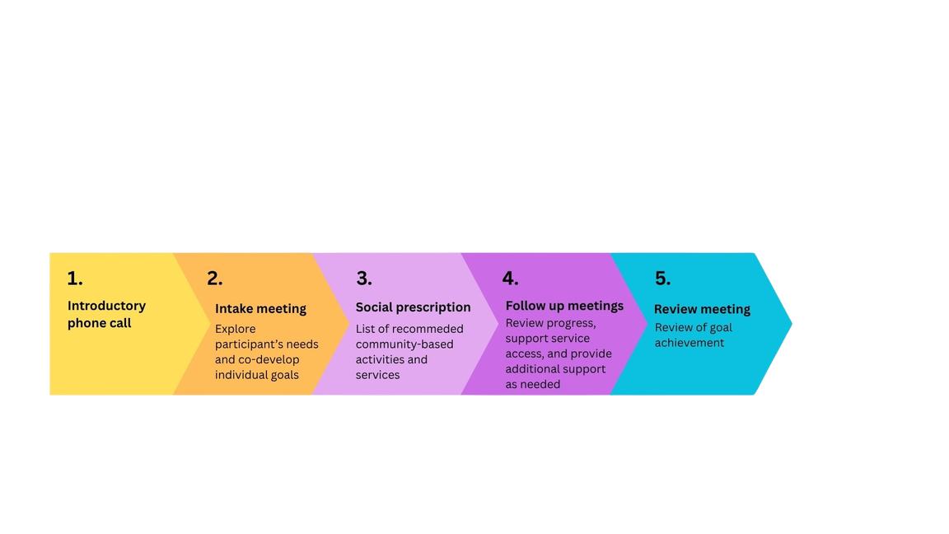
Contact us
Dr Kimberley J Smith (Lead Investigator) kimberley.j.smith@surrey.ac.uk
Dr Erica Ranzato (Researcher) e.ranzato@surrey.ac.uk
Visit the CP Link study webpage
ISSUE 2 - JULY 2026
CP LINK NEWSLETTER
The CP link worker study is now live!
We are pleased to share that the CP Link worker study is now underway. This means that adults with CP, aged 40 and over, living in North Central London (Barnet, Camden, Enfield, Haringey, and Islington), can take part in the study, receive support from the CP Link Worker, and provide feedback on their experience. We have been recruiting participants since February 2026, and we are very grateful to everyone who has already taken part.
What does taking part involve?
Participants will be able to work with Theo McCarthy Budzynski, the CP Link Worker, over a period of up to 3 months. Theo will support them through a five-step programme (Figure 1), to help them identify what matters most to them and set individual goals to improve their wellbeing. He will also connect them with non-clinical local activities, services, and opportunities to help them achieve these goals.
Figure 1. Overview of the CP link worker programme
However, this project is not only about accessing a new specialised service for adults with CP. It is also about building it together. A key part of the study is that participants help evaluate the programme and contribute to developing and improving the CP Link Worker programme and how the service is delivered. As part of the evaluation process, we ask participants to share their experiences with us over time and to complete three surveys. Participants can also take part in an interview at the end of the study. We know this takes time and effort, but it is essential for us to build strong evidence about what works - and what does not - for adults with CP.

Slide 2
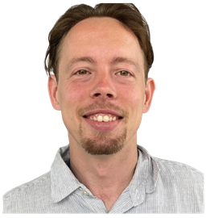
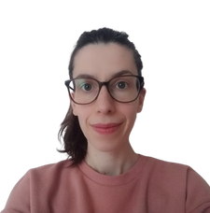
ISSUE 2 - JULY 2026
CP LINK NEWSLETTER
Spotlight on team members
If you decide to take part in the study, you will be in contact with Theo, our CP Link Worker, and Erica, the researcher who looks after the evaluation part of the study. We have spoken with them and put together short interviews so you can get to know them and learn more about their role.
Can you tell us about your work as CP Link worker?
My work as a CP link worker involves supporting people to age well with Cerebral Palsy. This involves connecting them to their community to support their wellbeing. During our work together we will find things that they care about through conversations to discover their interests. This leads to linking them to relevant groups that meet their needs. It also involves working together with service providers to ensure any groups I am referring to are accessible and if they are not finding alternative groups to signpost people to. It’s about relationship building the more you know about someone the more effective support you can give.
Theo McCarthy Budzynski
CP Link worker, UP
What matters most in your role?
I am happiest at work when I can see others progress and shine. Developing stronger and healthier communities is what matters to me most in my work. I try to do this with energy and enthusiasm. I enjoy working with people, hearing their stories and making positive change in their lives.
How are people taking part in the study helping to develop the CP Link service?
By completing three surveys and one optional interview, participants help us understand what is working well, what could be improved, and how the CP Link worker service is making a difference.
Their views will help shape the development of the CP Link Worker service to better meet the needs of adults with CP and will inform its future development and potential wider implementation.
Dr Erica Ranzato
Researcher, University of Surrey

